Slide 1
EENG 284 Lab 6
Calculator with Friendly Display
Notes:
Usually the <title of the lab> is what will be called the “System” through the rest of this document

Slide 2
Lab Objectives
Calculator that can
add/sub 4-bit values
unsigned and signed
Display as decimal digital
Logic
2’s complement numbering
Arithmetic circuit elements
Verilog
Simulation
Synthesis

Slide 3
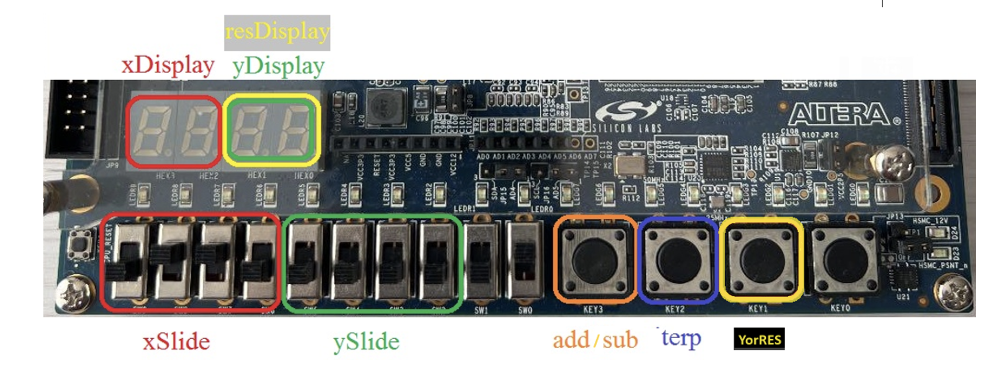
User Interface and Behavior
Input: pair of 4-bit values
Interpreted as signed or unsigned based on interp button
Input: Add or subtract input operands based on addSub button
Output: signed decimal value on resDisplay based on YorRES
Notes:
The leftmost button, add/Sub, specifies the operation performed on xSlide and ySlide.
When the button is unpressed the result is and xSlide + ySlide and the result is xSlide - ySlide when the button is pressed.
The interp button determines how the values are displayed on 7SD.
When unpressed, the 7SD show the decimal value, when pressed, the 7SD show 2’s complement.

Slide 4
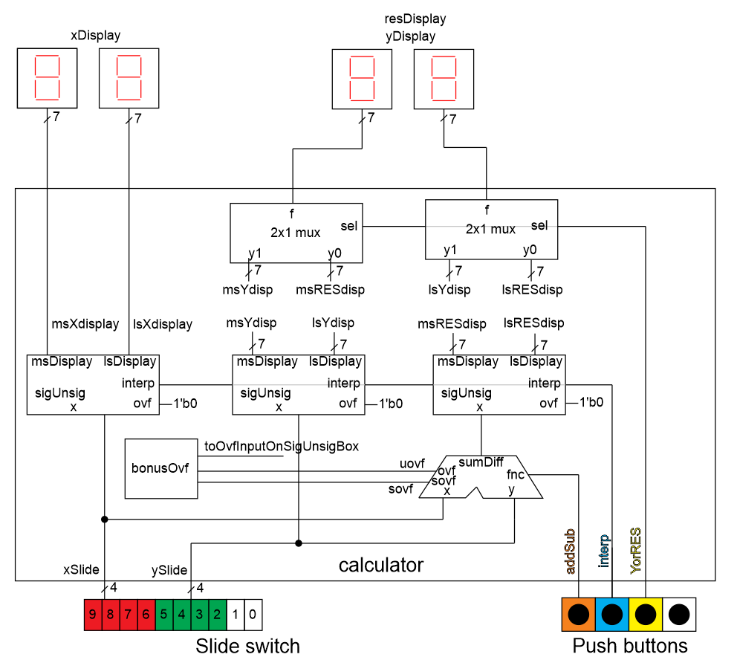
System architecture
Notes:
A significant challenge is to convert display a decimal interpretation of the 2’s complement or unsigned value

Slide 5
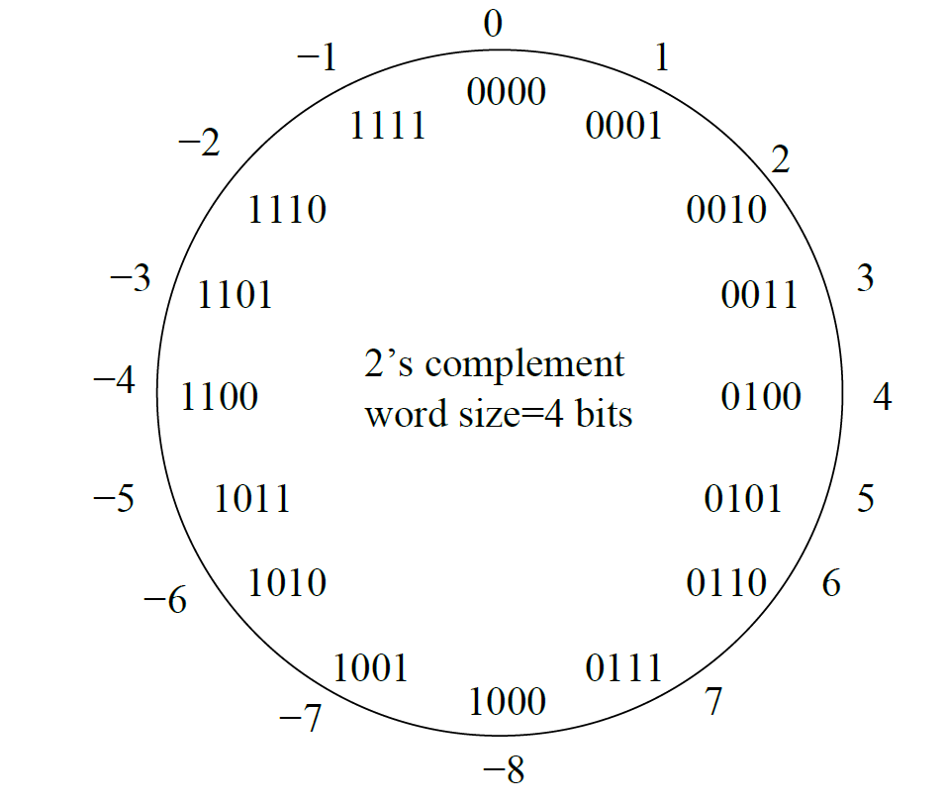
2’s complement
Bits do not have meaning
Bits have interpretations
Interpretations give bits value

Slide 6
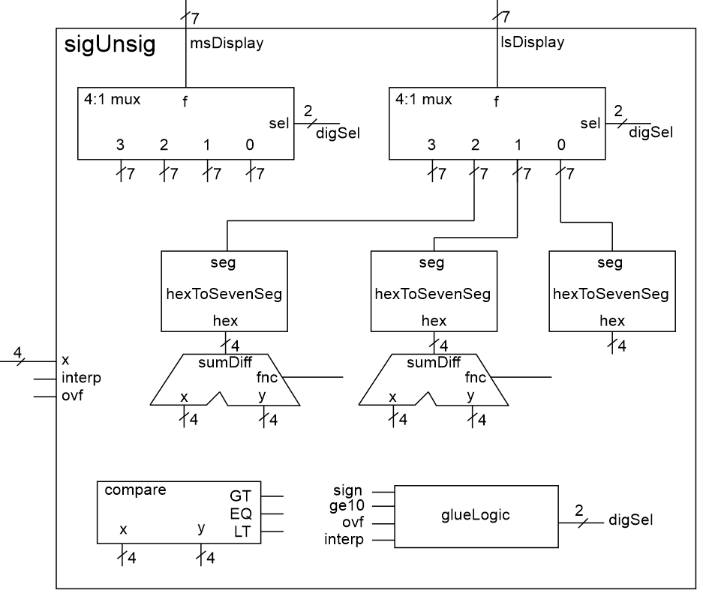
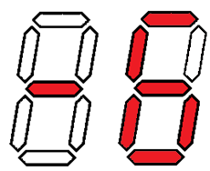
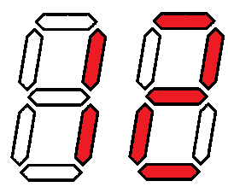
sigUnsig Module
x=4’b1010
interp = 1
ovf = 0
x=4’b1010
interp = 0
ovf = 0
Notes:
Interp = 1 means interpret as a signed 2’s complement value
Interp = 0 means interpret as unsigned decimal value

Slide 7
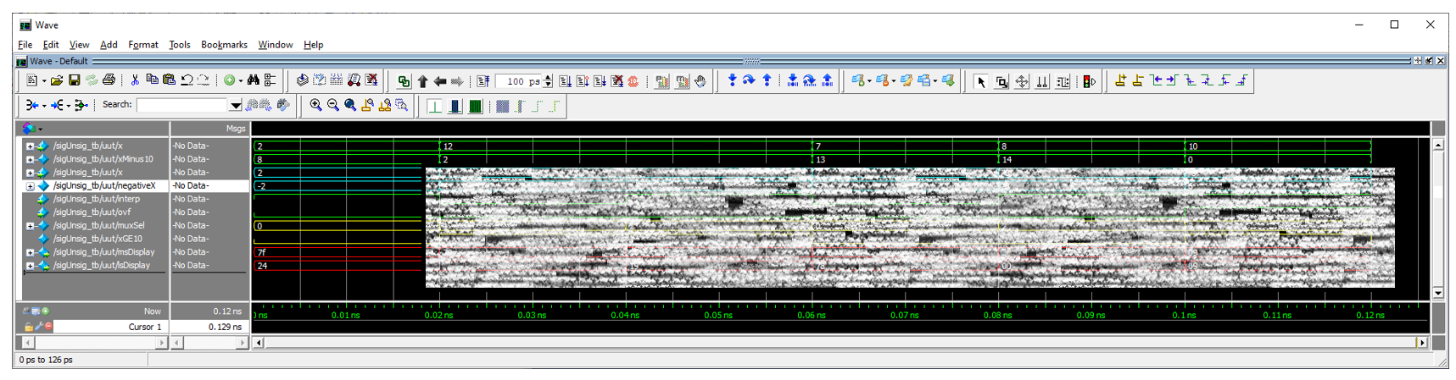
Deliverables
sigUnsig Testbench
Working calculator implementation on DE2-115 boards
Bonus – PERFECT overflow detection

